Slide 1

Gender Equality & Workforce Diversity Analytics

Slide 2


Addressing SDG Goal 5
■
Global Mandate: Aligned with the United Nations Sustainable Development Goal 5 to achieve true gender equality.
■
Strategic Purpose: Leverage Data Analytics and Machine Learning to scientifically audit workforce dynamics.
■
Scope Identification: Transition from anecdotal assumptions to hard, quantifiable data concerning diversity.
■
Systemic Focus: Uncover hidden biases across compensation structures, promotion funnels, and executive leadership selection.

Slide 3
Unprecedented Project Scale
120K
Massive Data Footprint
This initiative represents one of the most comprehensive internal audits conducted, spanning a massive global workforce of 120,000 active employees.
Employees Audited Globally
By analyzing such a vast dataset, the statistical significance of our findings guarantees that identified trends are deeply embedded systemic realities, rather than isolated departmental anomalies.

Slide 4


Core Analytical Objectives
1. Pay Gap Audit
2. Promotion Bias Analysis
Rigorously quantify the median salary difference between genders. This goes beyond base salary, encompassing total compensation including annual bonuses, stock options, and retention packages across identical job levels.
Compare historical promotion rates and track velocity of career advancement. The goal is to identify mathematical predictors of advancement and isolate instances where demographic factors outweigh pure performance metrics.

Slide 5






Core Analytical Objectives
Workforce Distribution
Predictive Modeling
Employee Segmentation
Visually map gender density across all organizational strata, from entry-level departments up to the C-suite executive board.
Engineer custom Machine Learning models to forecast employee promotions, thereby exposing the hidden weights currently applied to advancement criteria.
Utilize clustering algorithms to group employees and identify distinct demographic profiles that are disproportionately marginalized or favored.

Slide 6
Technical Architecture

Slide 7






The Tech Stack Breakdown
Data Manipulation
Visualization Engine
Machine Learning
Driven entirely by Python. Utilized Pandas for complex DataFrame operations, aggregations, and cleaning, alongside NumPy for high-performance numerical computations.
Generated high-contrast, executive-ready reports and plots utilizing Matplotlib and Seaborn to make abstract data instantly interpretable.
Powered by Scikit-Learn. Deployed advanced Random Forest classifiers for predictions and K-Means algorithms for unsupervised clustering.

Slide 8
Preprocessing Infrastructure
Label Standardization
Feature Scaling
Employed Scikit-Learn's LabelEncoder to convert complex categorical text data (e.g., Department names, Job Roles) into machine-readable numerical formats, ensuring algorithmic compatibility without losing contextual fidelity.
Implemented StandardScaler to normalize variance across vastly different numerical ranges (e.g., Age vs. Salary). This prevents variables with larger magnitudes from unfairly dominating the Machine Learning models.

Slide 9
The Machine Learning Framework
■
Supervised Learning: The Random Forest classifier acts as our primary predictive engine, analyzing historical data to understand "who gets promoted and why."
■
Unsupervised Learning: K-Means clustering operates without pre-defined labels, finding hidden mathematical similarities among employees that human analysts might miss.
■
Bias Detection: By analyzing the feature importance outputs of these models, we transition from observing bias to mathematically proving its specific drivers.

Slide 10
The Data Pipeline
Ensuring data integrity, handling anomalies, and engineering actionable metrics.

Slide 11
Data Cleaning Protocol
Gender Standardization: Normalized highly fractured gender labels (e.g., "M", "female", "NB", "Male_1") into a strict, unified format: Male, Female, Non-Binary.
Outlier Eradication: Filtered Age parameters strictly to a valid working range (18–70) and systematically handled impossible entries, such as negative Experience_Years.
Record Integrity Validation: Dropped any records with fundamentally missing demographic target data (like gender) to ensure the baseline audit metrics remained impeccably accurate.

Slide 12
Handling Missing Data
The Challenge
The Median Imputation Solution
In a dataset of 120,000 employees, missing compensation data (salaries and bonuses) is inevitable due to varied HR software migrations, recent acquisitions, and simple administrative errors. Deleting these records would compromise scale.
Instead of global averages, missing salaries and bonuses were precisely imputed using the median values strictly relative to the employee's specific Department and Job_Level, preserving intra-departmental variance.

Slide 13

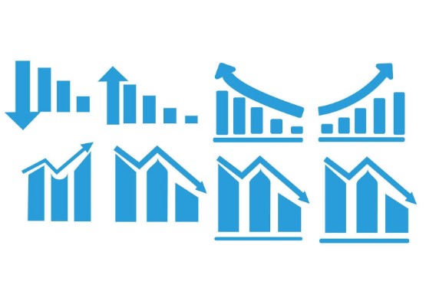
Feature Engineering: Compensation
■
Total_Compensation: Base Annual_Salary combined with total allocated Bonus. Crucial because base pay may be equal, but bonus distribution often harbors hidden bias.
■
Pay_Per_Experience: Total compensation normalized mathematically by years of professional experience.
■
The Objective: These synthetic features allow us to compare an employee's value exactly against their tenure, removing the excuse of "seniority" from pay gap discussions.

Slide 14






Feature Engineering: Diversity Metrics
Pay_Gap_Index
Diversity_Score
Hiring Ratio
Calculates the exact percentage deviation of a specific gender's median salary relative to the overarching departmental median.
A proprietary weighted index (ranging 0–1) calculated per employee based on gender representation, promotion history, and training investment.
A rolling metric tracking the real-time Male to Female intake proportion, identifying bias at the earliest stage of the employee lifecycle.

Slide 15
Key Performance Indicators (KPIs)
Analyzing the raw outputs. The data reveals critical areas requiring immediate strategic intervention.

Slide 16
The Global Gender Pay Gap
26.4%
A High Priority Alert
The analysis conclusively proves a sweeping 26.4% gender pay gap across the organization. In real terms, this means women earn approximately $26,000 less per year on average than their male counterparts.
Median Salary Difference
This disparity persists even after controlling for years of experience and job level, indicating a deep-rooted systemic issue rather than mere demographic coincidences.

Slide 17
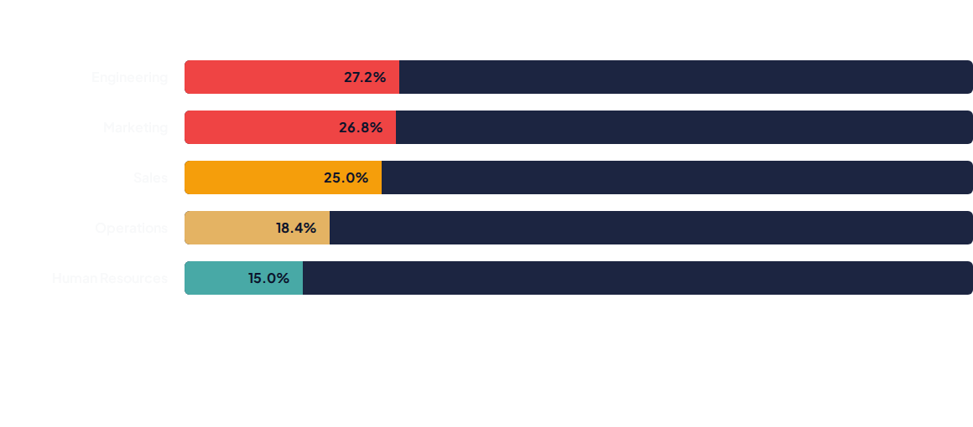
Pay Gap Variances by Department
The disparity is not uniform. The widest gaps are concentrated in historically male-dominated sectors like Engineering (27.2%), signaling an urgent need for targeted, departmental salary audits.

Slide 18
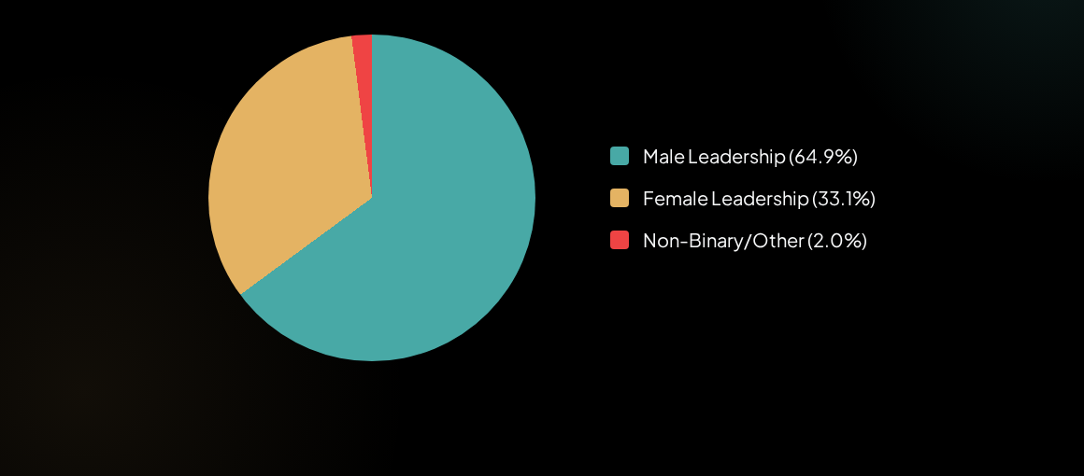
Leadership Pipeline Breakdown
The data shows a severe female drop-off that aggressively accelerates transitioning from Senior to Director level roles, strangling the diverse leadership pipeline.

Slide 19
Promotion Bias Reality
2.3%
Consistent Across All Departments
Analysis reveals a systemic promotion gap. The male promotion rate sits at 21.9%, while the female promotion rate lags at 19.6%.
Promotion Gap
While a 2.3% difference may appear small annually, this gap compounds year-over-year over a decade-long career, mathematically preventing women from reaching the C-Suite at equitable speeds.

Slide 20
The "Hidden" Disparities
Training Access Gap: Men receive an average of 6.8 more training hours per year than women. This directly impacts upskilling, resume building, and future promotion viability.
Turnover Inequality: Female turnover is notably higher at 18.0% compared to male turnover at 15.1% (a 2.9% gap).
The Result: We are losing female talent faster than we can promote them, heavily driven by lack of development opportunities and persistent compensation gaps.

Slide 21
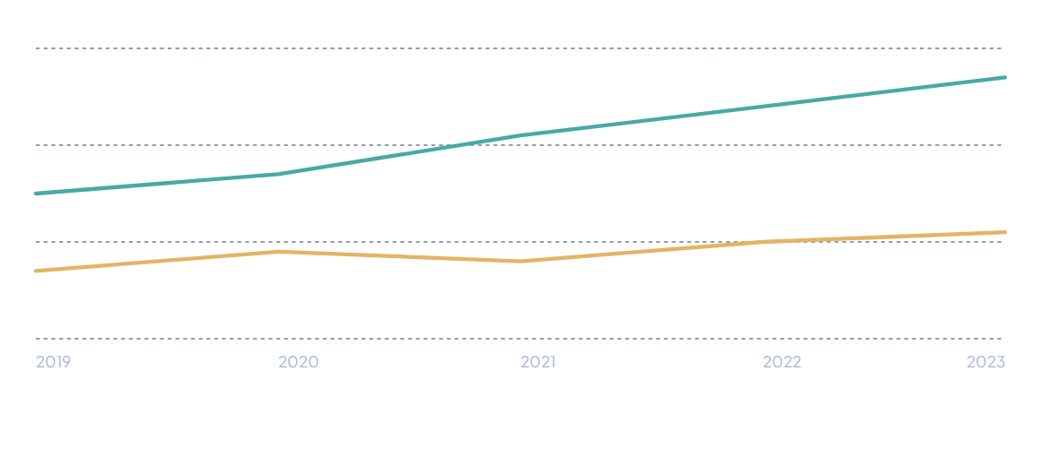
5-Year Turnover Trends
— Female Turnover (Rising to 18%)
— Male Turnover (Stable at ~15%)
The trendline clearly illustrates female attrition steadily increasing over the last 3 years, confirming retention strategies are failing specific demographic segments.

Slide 22
Machine Learning Insights

Slide 23
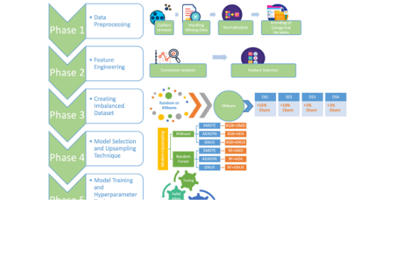
Promotion Prediction (Random Forest)
■
The Task: We trained a Random Forest model to predict if an employee is likely to be promoted based entirely on their performance reviews, training hours, and current compensation.
■
Feature Importance Extraction: Rather than just predicting, we interrogated the model to see which variables it relied on most heavily to make its decisions.
■
The Result: Performance scores were surprisingly outranked by existing compensation.

Slide 24
ML Finding: The Compounding Bias
The Feedback Loop
Reinforcing the Hierarchy
The ML model decisively identifies Salary and Bonus as the top predictors for future promotion. If an employee is already paid highly, they are statistically far more likely to be promoted again.
Because women currently suffer a 26.4% pay gap, this ML finding suggests that current compensation disparity automatically acts as a bottleneck, artificially restricting female promotion rates and compounding the bias exponentially over time.

Slide 25





Workforce Segmentation (K-Means)
Cluster A: High Diversity Entry
Cluster B: The Squeeze
Cluster C: Entrenched Execs
High gender parity, low compensation. Represents our massive entry-level intake.
Mid-career, rising salaries. This cluster shows the exact inflection point where female talent drops off.
Highest compensation, lowest diversity. Overwhelmingly male and isolated from the broader workforce metrics.

Slide 26
Actionable Insights & Directives

Slide 27

Priority Action Matrix
Identified Issue | Priority | Targeted Action Plan
26.4% Pay Gap | CRITICAL | Initiate mandatory pay equity audits; enforce rigid salary bands.
33.1% Leadership Ratio | CRITICAL | Launch fast-track programs; enforce a 40% female C-Suite target by 2027.
Promotion Disparity | HIGH | Implement blind promotion reviews and explicitly structured criteria.
Training & Turnover | HIGH | Mandate equal-access training budgets; expand parental leave and flex-work.

Slide 28
Addressing the "Compounding Bias"
Decouple Promotion from Compensation: Per the Machine Learning findings, HR must explicitly instruct evaluation committees to ignore current salary metrics when determining promotion viability.
Standardize Intake Offers: The pay gap begins at hiring. Remove salary negotiation from the entry-level hiring process entirely to prevent aggressive negotiating tactics from establishing early, unclosable gaps.
Data-Driven Exit Interviews: Specifically target the 18% female turnover bracket. Transition from generic exit forms to deep-dive interviews focusing on departmental culture and parental support.

Slide 29






Generated Project Assets
Data Files
Visual Assets
Live Dashboard
cleaned_gender_data.csv (The processed raw dataset) and gender_metrics.csv (High-level KPI summary outputs).
eda_plots.png (Visualizations of distribution) and ml_model.png (Feature importance & performance).
dashboard.html (An interactive visualization summary deployed for leadership access and drill-down metrics).

Slide 30
Thank You

